Slide 1
Natural Language Processing
By group 1

Slide 2
Data Loading & Preprocessing
This section handles preparing the data so it can be used by the models later.
It usually includes:
Installing dependencies – making sure all Python libraries (like TensorFlow, Gensim, etc.) are available.
Importing libraries – such as numpy, pandas, and keras for modeling and data manipulation.
Loading the dataset – probably a Swahili sentiment dataset (e.g., tweets or reviews labeled as positive/negative).
Text preprocessing – cleaning and normalizing text (removing punctuation, stopwords, tokenizing, lowercasing).
Splitting data – dividing into training, validation, and test sets.
Essentially, this section prepares clean, tokenized text and labels for later models.

Slide 3

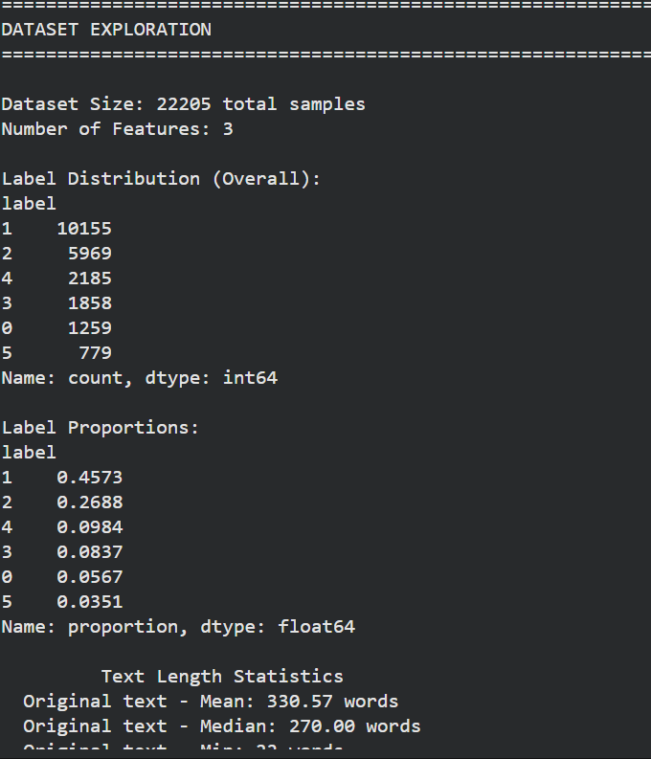
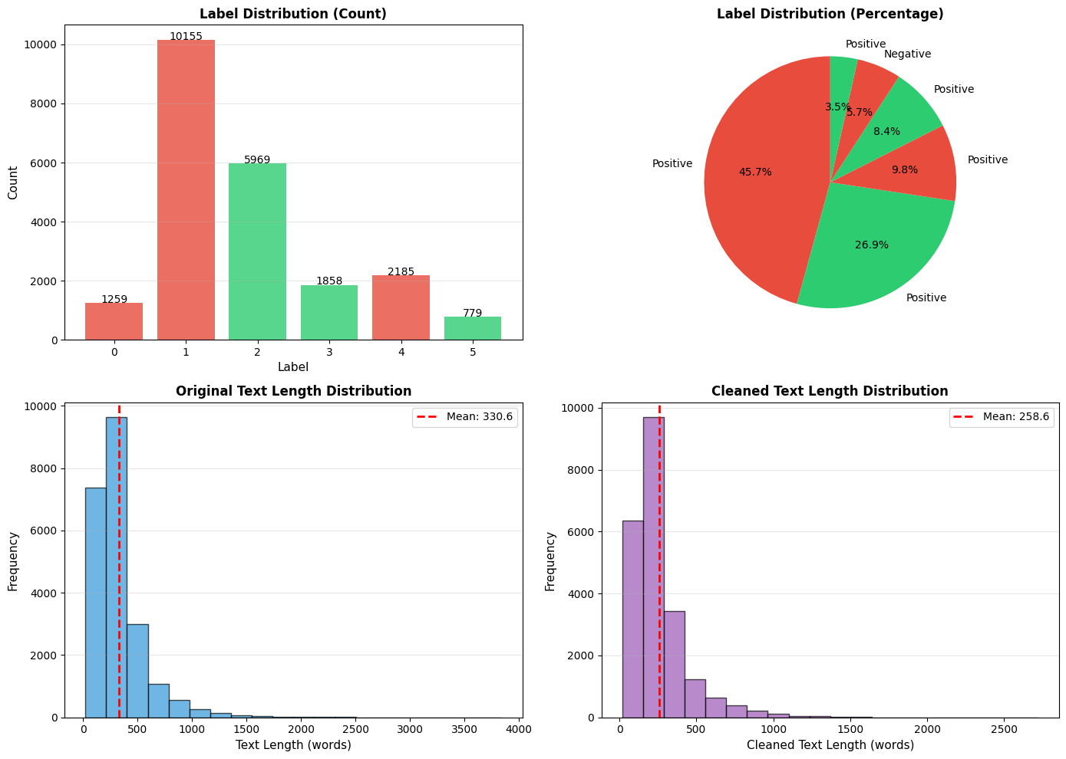




Slide 4

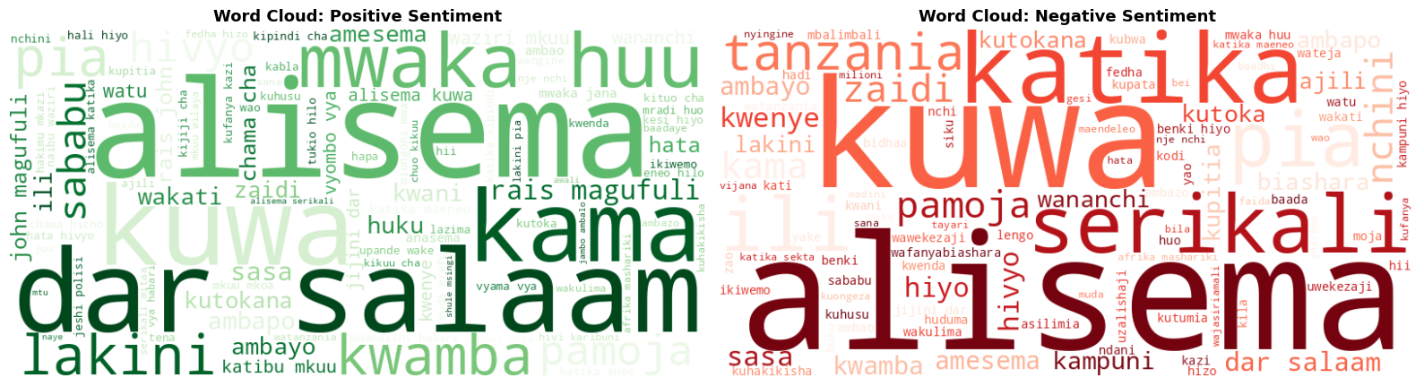

Slide 5
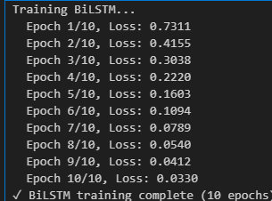
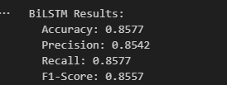
BiLSTM Model with Custom Embeddings
Here the notebook builds a Bidirectional LSTM (BiLSTM) model — a type of recurrent neural network that reads text in both forward and backward directions, capturing context more effectively.
Steps include:
Defining the model architecture – embedding layer, BiLSTM layer(s), dense layer for classification.
Training the model – feeding the preprocessed text data into it.
Evaluating the model – checking accuracy, F1-score, or confusion matrix.
This demonstrates how to build a sequence-based sentiment classifier using deep learning from scratch.

Slide 6
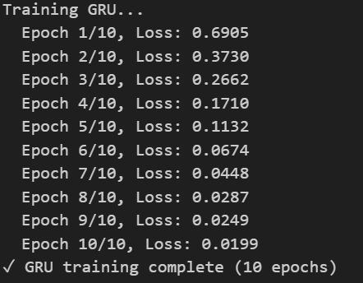
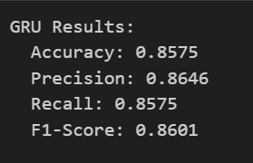
GRU Model
This section repeats a similar process, but with a Gated Recurrent Unit (GRU) model instead of BiLSTM.
A GRU is a more efficient alternative to LSTM that often performs similarly but trains faster.
Here, the idea is to compare how GRU performs on the same task and dataset.

Slide 7
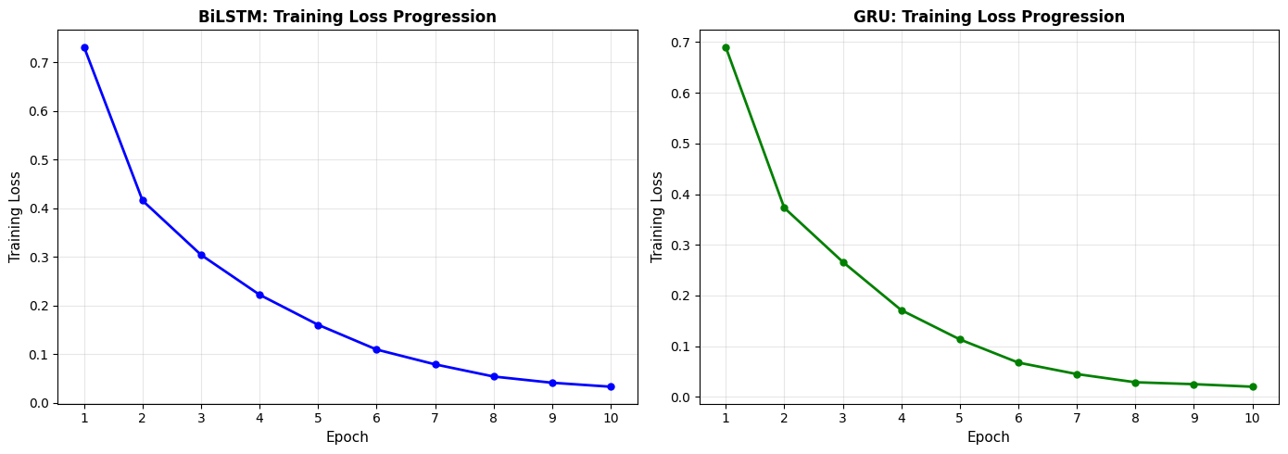
Training loss validation

Slide 8

3. Word2Vec Embeddings
Now the focus shifts to word embeddings, specifically Word2Vec, which learns vector representations of words based on their contexts in text.
In this section:
A Word2Vec model is trained on the dataset (or pre-trained vectors are loaded).
The notebook extracts word embeddings for each text sample.
These embeddings are then used to train a simpler classifier (like logistic regression) for sentiment prediction.
The goal is to show that even without deep networks, word embeddings + classical ML can perform well.

Slide 9
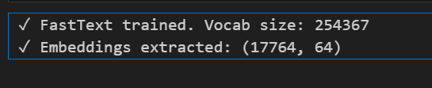
4. FastText Embeddings
This section introduces FastText, another embedding method created by Facebook AI that extends Word2Vec by considering subword information (useful for morphologically rich languages like Swahili).
Steps typically include:
Training or loading FastText embeddings.
Representing text as averaged FastText vectors.
Using those vectors for classification (e.g., logistic regression, SVM).
The main goal here is to show that FastText handles rare words and local languages better than Word2Vec.

Slide 10
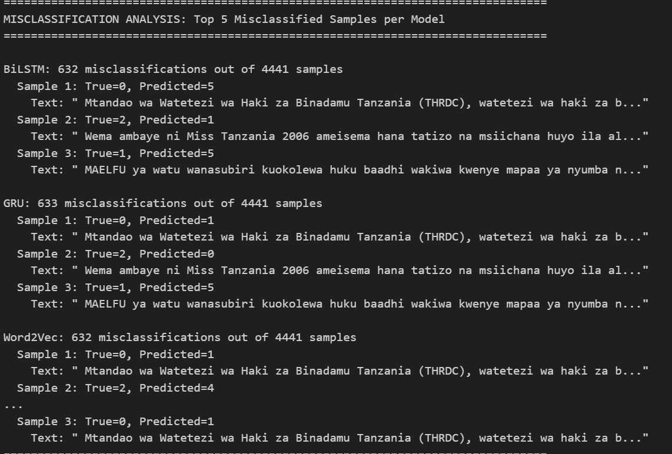
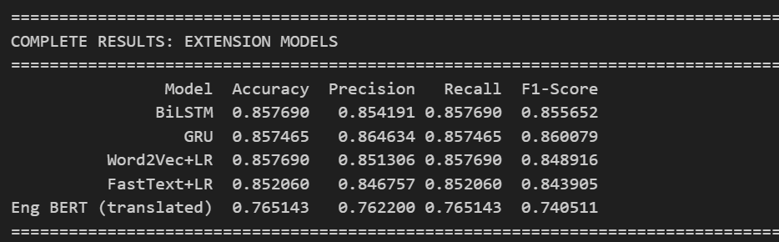
Model comparision
Here we used confusion matrix and misclassification analysis

Slide 11
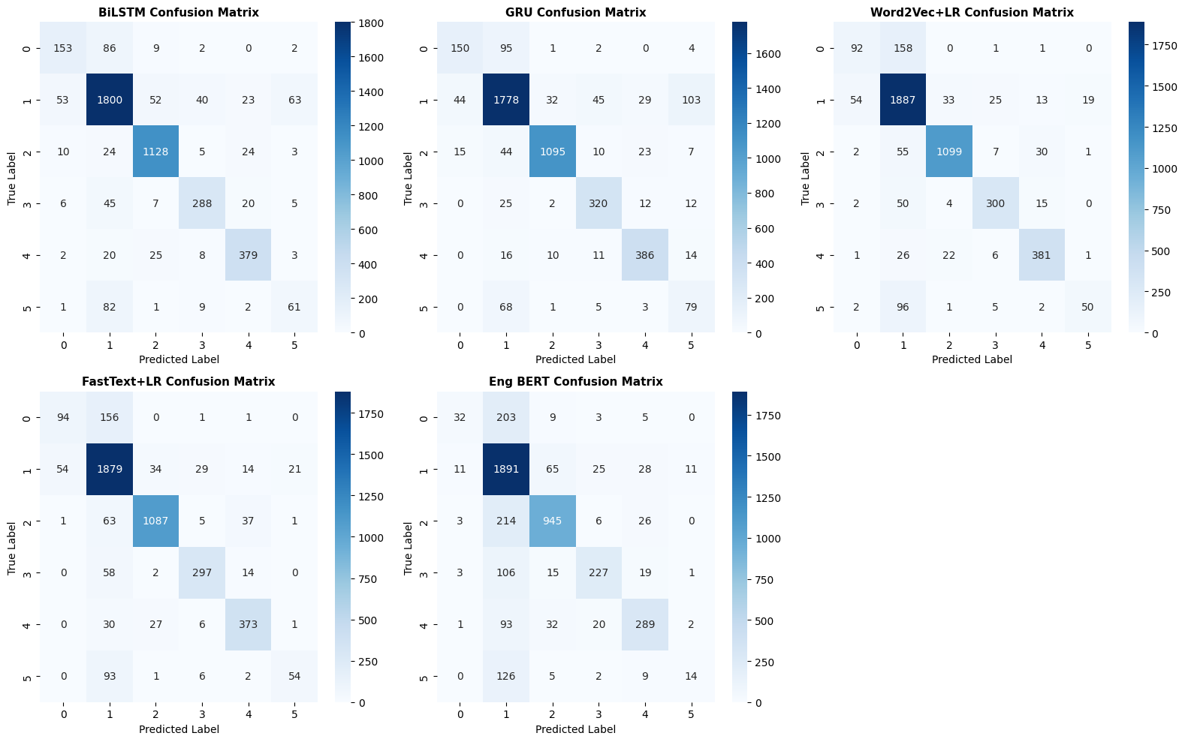

Slide 12
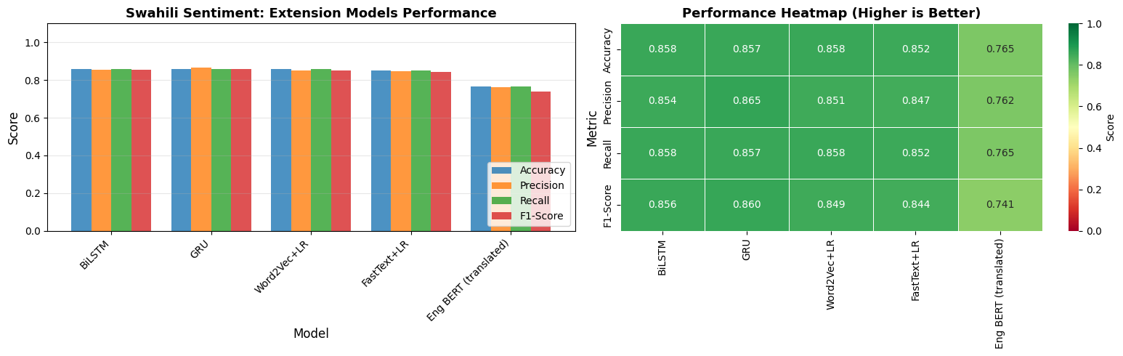

Slide 13
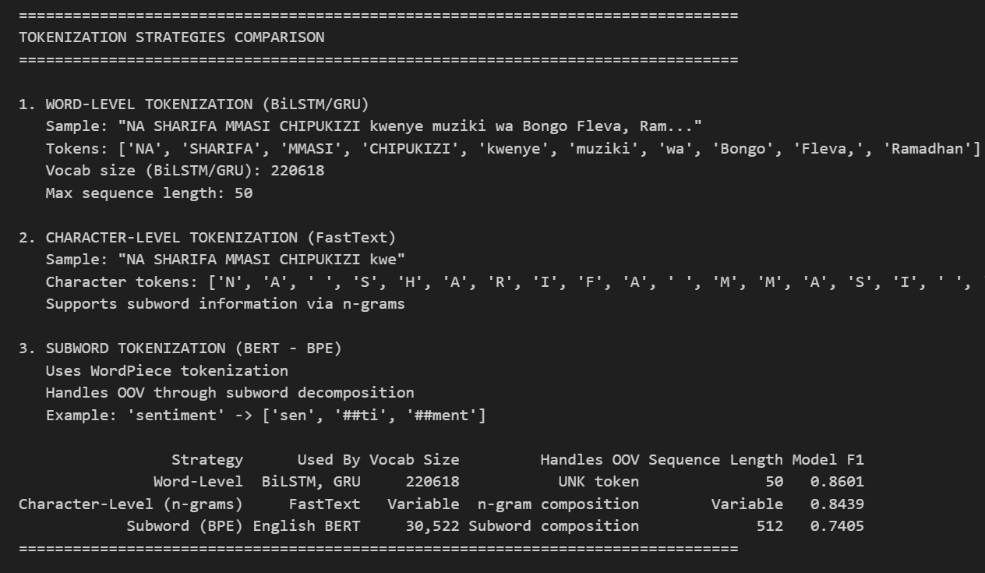
Tokenization strategies and Embedding analysis

Slide 14
